Slide 1
BPEL Designer
SOA-based Business Integration with Eclipse

Slide 2
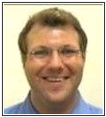
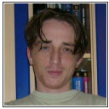
The presenters
Simon Moser, IBM Corp.
  Co-lead of the BPEL Designer Project
  Member of the WS-BPEL technical Committe at OASIS
Oleg Danilov, Intel Corp.
  Committer to the BPEL Designer Project
  Open Source Enthusiast (also contributor to the Apache Harmony Project)

Slide 3
Outline of the presentation
Introduction
WS-BPEL concepts and their realization in our tool
BPEL Designer: Important features and relations
Demo

Slide 4
Part 1: Introduction
What is Business Process?¹
  A business process is a set of coordinated tasks and activities that will lead to accomplishing a specific organizational goal. Tasks and activities can be represented as (web) services.
What is a (Web) Service?¹
  Web services (sometimes called application services) are services (usually including some combination of programming and data, but possibly including human resources as well) that are made available from a business's Web server for web users or other web-connected programs.
¹ – definitions taken from whatis.com

Slide 5
Introduction: What is WS-BPEL
WS-BPEL describes in an SOA how your company performs its business processes
With WS-BPEL, it is straightforward to let your business partners and customers directly participate in your business processes
With WS-BPEL, it is straightforward to tie in web services as activities of your business processes

Slide 6

Introduction: Why WS – BPEL?
WSDL defined Web services have a stateless interaction model
  Messages are exchanged using
    Synchronous invocation
    Uncorrelated asynchronous invocations
Most “real-world” business processes require a more robust interaction model
  Messages exchanged in a two-way, peer-to-peer conversation lasting minutes, hours, days, etc.
WS-BPEL provides the ability to express stateful, long-running interactions

Slide 7
Part 2: BPEL Concepts and Realisation
Variables
WSDL Message
Basic
Activities
Partner
Links
receive
exit
reply
throw
42
XML Schema
Type
XML Schema
Element
partner
link
partner
link
invoke
rethrow
assign
wait
validate
compensate
process
Partner
Link Type
empty
compensateScope
Port
Type 1
Port
Type 2
extensionActivity
receive
receive
invoke
Structured
Activities
invoke
Handlers
flow
pick
invoke
event
handler
fault
handler
sequence
forEach
event
handler
fault
handler
while
if-else
Properties
Correlation Sets
compensation
handler
termination
handler
repeatUntil
scope
Property 1
Property 2

Slide 8
BPEL Concept: Basic Activities
process
Do a blocking wait for a
matching message to arrive / send a message in reply
Immediately terminate execution of a business process instance
receive
reply
exit
Invoke compensation on all completed child scopes in default order
Invoke a one-way or
request-response operation
invoke
compensate
Update the values of variables or partner links with new data
assign
compensateScope
Invoke compensation on one completed child scope
Validate XML data stored in variables
validate
wait
Wait for a given time period or until a certain time has passed
Generate a fault from inside the business process
throw
empty
No-op instruction for
a business process
Forward a fault from inside a fault handler
rethrow
extensionActivity
Wrapper for language extensions

Slide 9
BPEL Concept: Structured Activities
process
Contained activities are executed in parallel, partially ordered through control links
flow
pick
Block and wait for a suitable message to arrive (or time out)
A
C
M1
M2
…
A
B
Contained activities are performed sequentially in lexical order
sequence
forEach
Contained activity is performed sequentially or in parallel, controlled by a specified counter variable
1.
2.
…
N.
1.
2.
…
N.
Contained activity is repeated while a predicate holds
while
if-elseif-else
Select exactly one branch of activity from a set of choices
c
c1
c2
…
Contained activity is repeated until a predicate holds
repeatUntil
scope
Associate contained activity with its own local variables, partner links, etc.,
and handlers
c

Slide 10
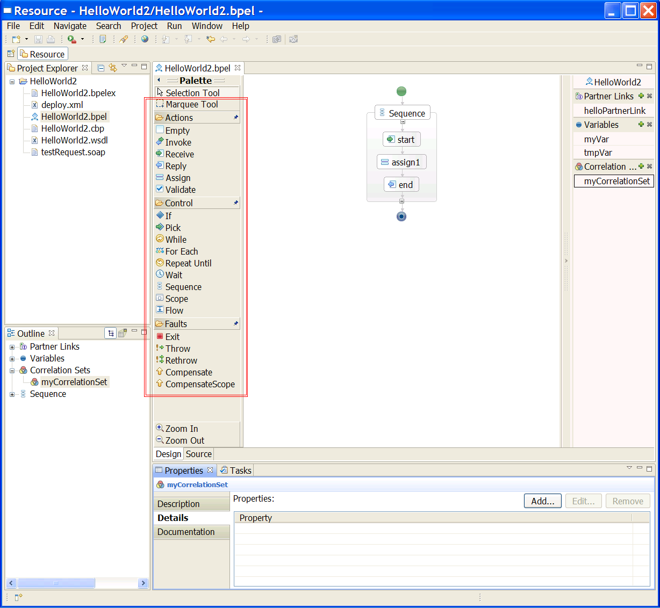
… and Realisation: Activities
This is just a dummy slide – we will show a demo here …

Slide 11
BPEL Concept: Partner Links
process
Peer-to-peer conversational partner relationship
partner
link
receive
invoke
Inbound request – service provided by the process
Outbound request – service required by the process
partner link type
WSDL
port type
myRole
partnerRole
WSDL
port type
Provided port type
Required port type
Notes:
Partner links are channels along which peer-to-peer conversations with partners take place

Slide 12
BPEL Concept: Variables
process
Variables defined using WSDL messages
request
request
receive
invoke
response
42
xsl:transform
response
reply
assign
WSDL
messages
42
XML Schema
elements / types
WSDL
message
XML
schemas
WSDL
message
Variables defined using XML schema elements or types
Notes:
Variables are typed using WSDL messages or XML Schema elements or simple/complex types
Activities’ input and output kept in scoped variables
Assignment activities move data around

Slide 13
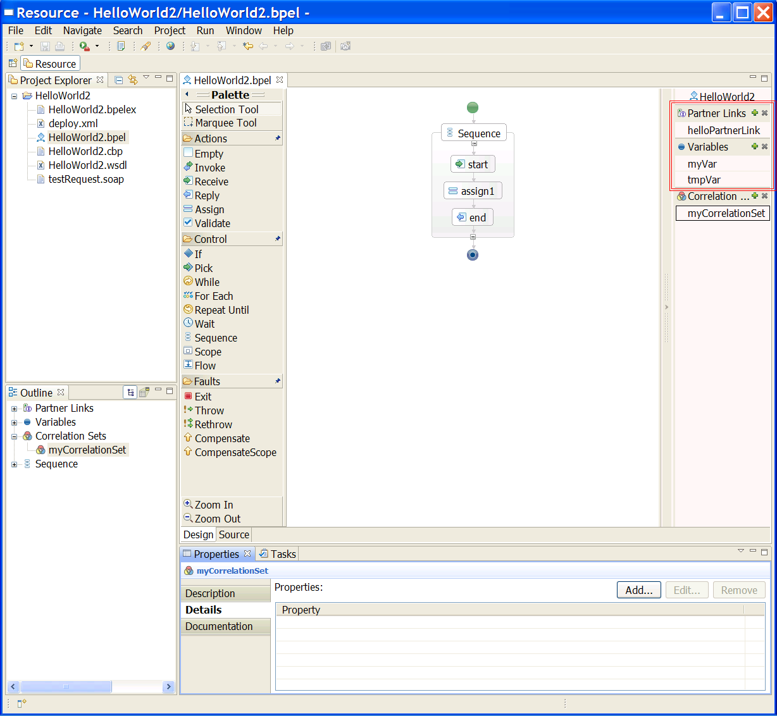
… and Realisation: Partner Links, Variables
This is just a dummy slide – we will show a demo here …

Slide 14
BPEL Concept: Variable Properties
process
A property creates a
name
that has
semantic significance
beyond an XML schema type
Properties
isolate the process logic
from the details of a
variable definition
←
getVariableProperty( variable, property )
WSDL message
property
alias
...
part
part
part
property
Typed properties are
mapped (aliased) to
parts of WSDL messages
or XML schema elements
XML schema element
property
alias
property

Slide 15
BPEL Concept: Properties and Correlation Sets
How to identify stateful instances via stateless WS interfaces?
A process instance is assigned one or more keys
  Business data is used as key, e.g., customerID
  A key can be compound, e.g., (customerID, orderNumber)
  WS-BPEL calls a key a correlation set – it is used to correlate an incoming message with a process instance
Process 4
(0123,15)
customerID
Process 3
(0815,42)
orderNumber
Process 2
(4711,37)
Message 1
4711
37
Process 1
(0815,12)
Message 2
0815
42

Slide 16
BPEL Concept: Properties and CorrelationSets
Submit purchase order
How to identify stateful instances
via stateless Web service interfaces?
process instance 1
purchaseOrder
cId = 0815
orderNo = 42
process
receive
initiate
process instance 2
correlation set
customerId
customerId
orderNumber
orderNumber
locate
process instance 3
process instance 3
receive
queryOrderStatus
custId = 0815
Messages in
long-running conversations
are correlated to
the correct process instance
(0311, 33)
1
oNo = 42
(0707, 11)
2
process instance 4
(0815, 42)
3
Query order status
(0815, 49)
4
Notes:
Typed properties defined in WSDL are named and mapped (aliased) to parts of several WSDL messages used by the process

Slide 17
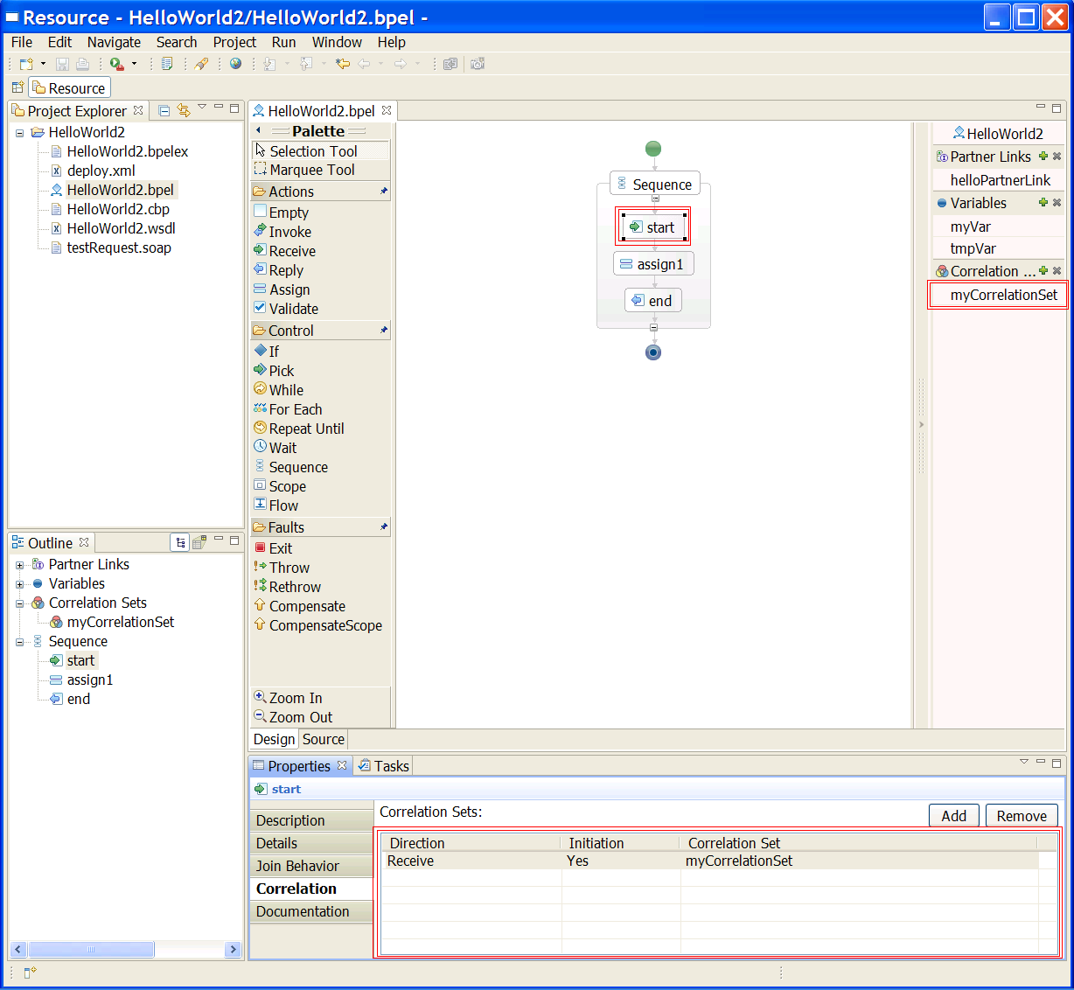
… and Realisation: Correlation
This is just a dummy slide – we will show a demo here …

Slide 18
BPEL Concept: Fault, Compensation Handling
process
fault
handler
scope
4. Compensate
previous work
compensation
handler
compensate
5. Propagate
compensation
compensate
compensation
handler
3. The fault triggers
the process-level
fault handler
invoke
compensation
handler
6. Undo work
(in reverse order)
invoke
invoke
invoke
1. Do some work (successfully invoke two services)
invoke
2. Invoke another service
(throws fault)

Slide 19
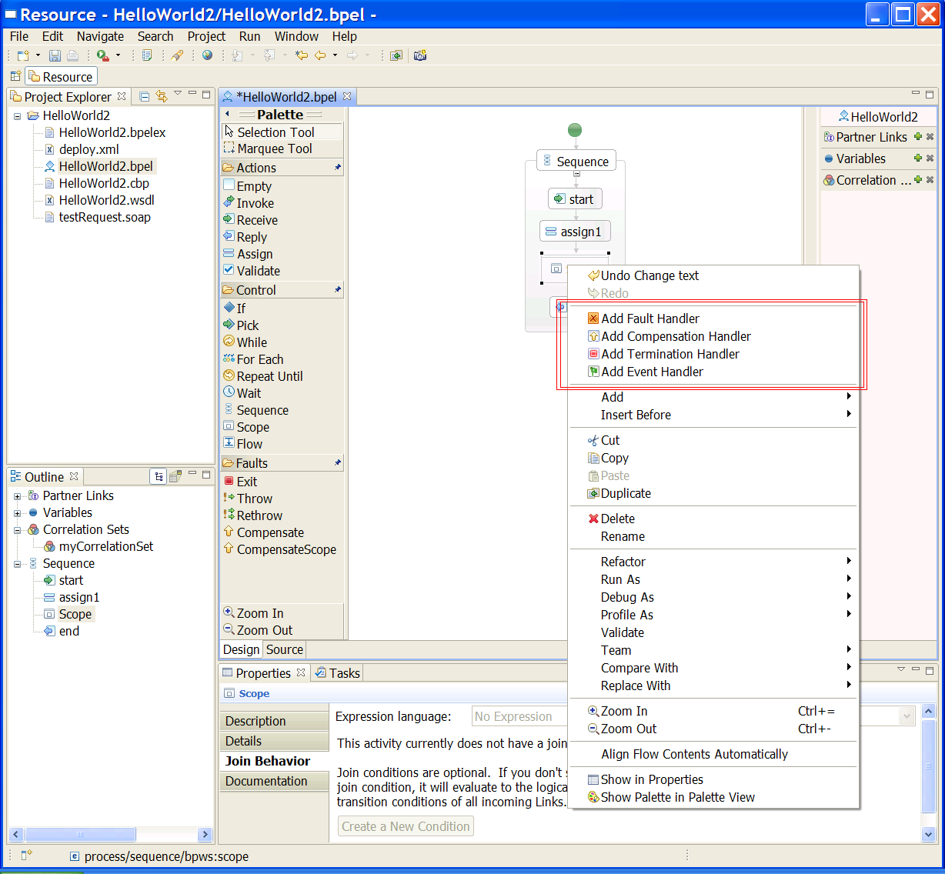
… and Realisation: Add a handler …
This is just a dummy slide – we will show a demo here …

Slide 20
Part 3: BPEL Designer: Standard Compliance
Support of BPELWS 1.1 (in version 0.1)
Support of BPEL 2.0 …
  … all standard activities are supported
  No full support of extensibility mechanisms yet (incl. extensionActivity)
  No support of abstract BPEL

Slide 21
Part 3: BPEL Designer: useful recent features
synchronized editable source view
Palette dockable / hideable / in a view
WSIL browser for discovering available web services
Export as image
Switch diagram orientation
Apache™ ODE runtime integration plugins (as reference runtime - not released yet)

Slide 22
Part 3: BPEL Designer relations
We use stuff from other Eclipse projects …
  WTP (for all the WSDL related stuff, e.g. creating a WSDL)
  DTP (for all the XSD related stuff, e.g. creating an XSD for a variable)
  …
We also use stuff from / make use of other open source projects ..
  e.g. Apache ODE

Slide 23
Part 3: BPEL Designer product exploitations
Intel™ SOA Expressway
  http://www3.intel.com/cd/software/products/asmo-na/eng/373233.htm

Slide 24
Part 4: Demo
Of course we could have used any of our companies runtime environments to show a demo …
… but in order to stay true to the open source idea …
… we used an open source BPEL engine called Apache ODE as reference runtime and wrote some integration code …

Slide 25
Part 4: Demo of „Model – Deploy - Run“
This is just a dummy slide – we will show a demo here …
Create a new „Hello World“ BPEL project
Model a business process
Create a new ODE server (see next slide)
Add the project to the server (see 2nd next slide)
Start the server (triggers the deploy)
Make sure the process is deployed (in ODE‘s admin console)
Run the process (eg. using SOAP UI to send messages)

Slide 26
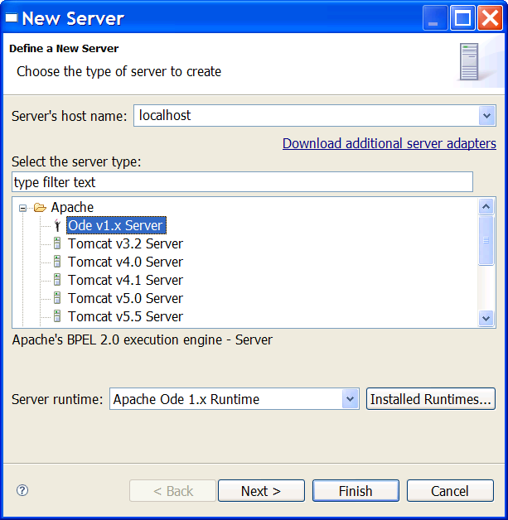
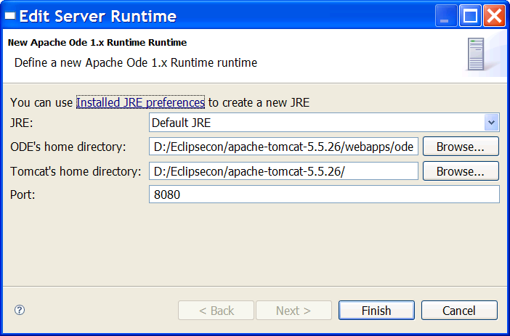
Demo: reference runtime integration (Apache ODE) (prototype screenshot – no released code)
This is just a dummy slide – we will show a demo here …

Slide 27
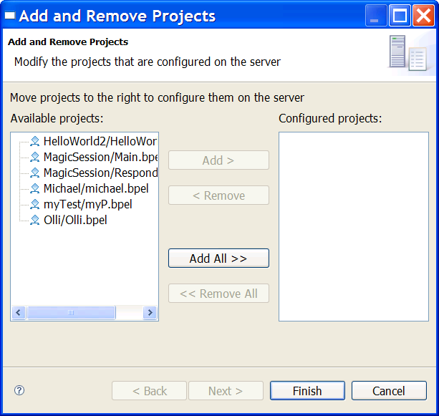
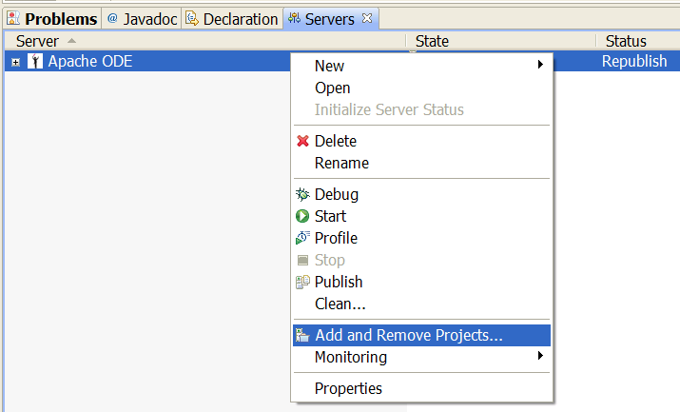
Demo: Add BPEL projects to Apache ODE server and deploy
This is just a dummy slide – we will show a demo here …

Slide 28
For more information …
Project hub:
  http://www.eclipse.org/bpel
Dev mailing list:
  bpel-dev@eclipse.org

Slide 29
Legal Notices
Copyright © IBM Corp., Intel Corp., 2008. All rights reserved. Source code in this presentation is made available under the EPL, v1.0, remainder of the presentation is licensed under Creative Commons Att. Nc Nd 2.5 license.
IBM and the IBM logo are trademarks or registered trademarks of IBM Corporation, in the United States, other countries or both.
Intel and the Intel logo are trademarks or registered trademarks of Intel Corporation, in the United States, other countries or both.
BEA and the BEA Logo are trademarks or registered trademarks of BEA Systems, Inc in the United States and other countries.
Oracle and the Oracle Logo are trademarks or registered trademarks of Oracle Corporation in the United States and other countries.
Apache and the Apache Logo are trademarks or registered trademarks of Apache Software Foundation in the United States and other countries.
Java and all Java-based marks, among others, are trademarks or registered trademarks of Sun Microsystems in the United States, other countries or both.
Eclipse and the Eclipse logo are trademarks of Eclipse Foundation, Inc.
Other company, product and service names may be trademarks or service marks of others.
THE INFORMATION DISCUSSED IN THIS PRESENTATION IS PROVIDED FOR INFORMATIONAL PURPOSES ONLY. WHILE EFFORTS WERE MADE TO VERIFY THE COMPLETENESS AND ACCURACY OF THE INFORMATION, IT IS PROVIDED "AS IS" WITHOUT WARRANTY OF ANY KIND, EXPRESS OR IMPLIED, AND IBM AND INTEL SHALL NOT BE RESPONSIBLE FOR ANY DAMAGES ARISING OUT OF THE USE OF, OR OTHERWISE RELATED TO, SUCH INFORMATION. ANY INFORMATION CONCERNING IBM'S OR INTEL’S PRODUCT PLANS OR STRATEGY IS SUBJECT TO CHANGE BY IBM OR INTEL WITHOUT NOTICE.

